Slide 1
How can we be better informed as citizens?

Slide 2
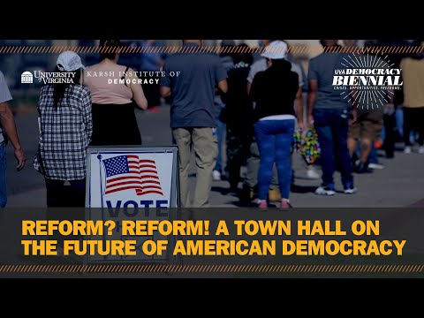
Introduction from Larry Sabato, what is a problem facing our democracy?

Slide 3
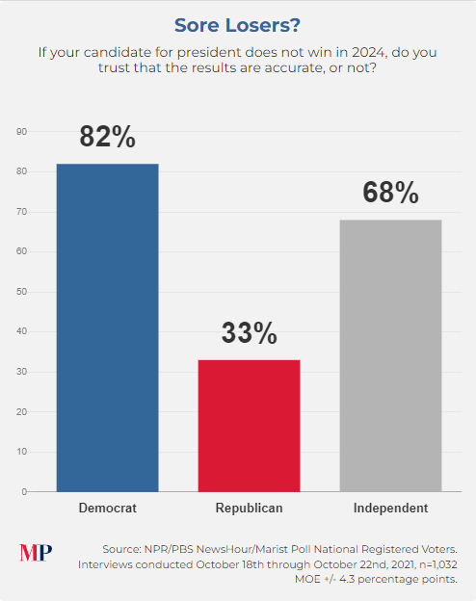
Notes:
https://maristpoll.marist.edu/polls/npr-pbs-newshour-marist-national-poll-trust-in-elections-threat-to-democracy-biden-approval-november-2021/

Slide 4
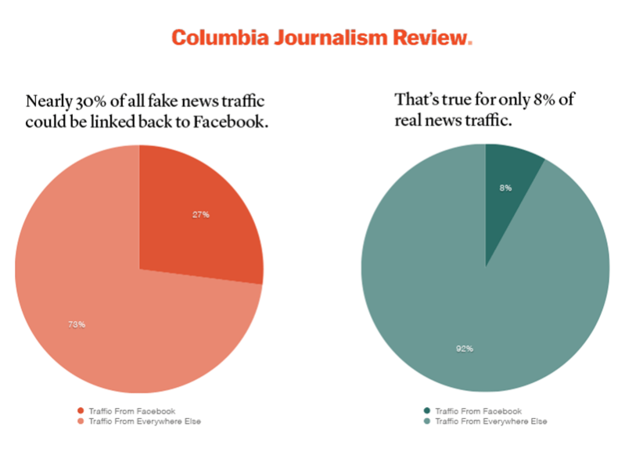

Slide 5
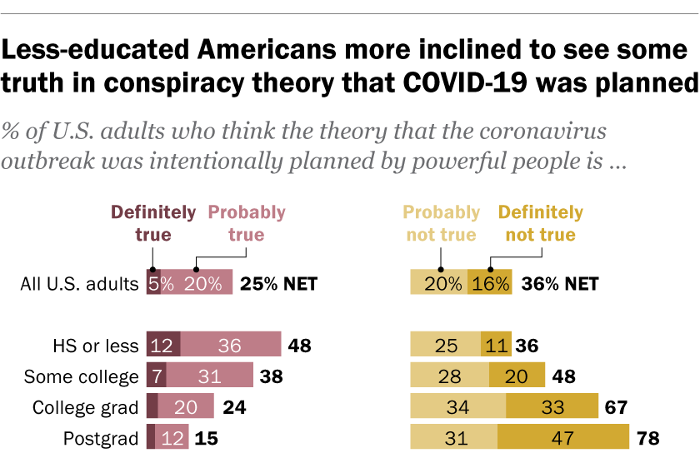
Notes:
https://maristpoll.marist.edu/polls/npr-pbs-newshour-marist-national-poll-trust-in-elections-threat-to-democracy-biden-approval-november-2021/

Slide 6
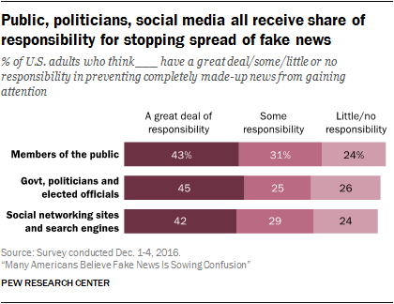

Slide 7
https://newsela.com/read/fake-news-history-teachers/id/25299/
https://newsela.com/read/fake-news-literacy/id/39256/
https://newsela.com/read/fake-news-fact-checker/id/24356/
https://newsela.com/read/fake-news-money/id/25296/
https://newsela.com/read/lib-ways-to-protect-yourself-from-disinformation/id/2001015435/

Slide 8
Read the attached article on fake news and a classroom solution. Complete the thinking routine below.
Connections:What connections do you draw between the article and your own life or the world around you?
Concepts: What key concepts or ideas do you think are important and worth holding on to from the article?
Changes: What changes in attitudes, thinking, or action are suggested by the text, either for you or others?
Challenge: What ideas, positions, or assumptions do you want to challenge or argue with in the article?

Slide 9
Read the attached article on fake news and individual responsibility. Complete the thinking routine below.
Connections:What connections do you draw between the article and your own life or the world around you?
Concepts: What key concepts or ideas do you think are important and worth holding on to from the article?
Changes: What changes in attitudes, thinking, or action are suggested by the text, either for you or others?
Challenge: What ideas, positions, or assumptions do you want to challenge or argue with in the article?

Slide 10
Read the article about fake news and business responsibility, and complete the thinking routine below.
Connections: What connections do you draw between the article and your own life or the world around you?
Concepts: What key concepts or ideas do you think are important and worth holding on to from the article?
Changes: What changes in attitudes, thinking, or action are suggested by the text, either for you or others?
Challenge: What ideas, positions, or assumptions do you want to challenge or argue with in the article?

Slide 12
How can we be better informed as citizens?

Slide 13
How can we be better informed as citizens?

Slide 14
How can we be better informed as citizens?

